Slide 1
ELEC3844 Engineering Management and Society Risk management and Crisis Management
Dr. Wilton Fok

Slide 2
Contents
Risk management
Risk Impact/Probability Chart
Risk and Return Curves
Crisis management
Crisis Communication

Slide 3
Risk Management
Risk management is an important function in organizations today.
Companies undertake increasingly complex and ambitious projects, and those projects must be executed successfully, in an uncertain and often risky environment.
As a responsible manager, you need to be aware of these risks.
Does this mean that you should try to address each and every risk that your project might face?

Slide 4
Risk Management
Probably not!
But we need to identify those most critical environments, which may be :
Too expensive
Too time consuming
Resources consuming
Vital and unrecoverable

Slide 5
Risk Management
Probably not!
But we need to identify those most critical environments, which may be :
Too expensive
Too time consuming
Resources consuming
Vital and unrecoverable
Instead, you need to prioritize risks.
If you do this effectively, you can focus the majority of your time and effort on the most important risks.
How to Prioritize Risks?
Have we prepared sufficiently for the worst?

Slide 6
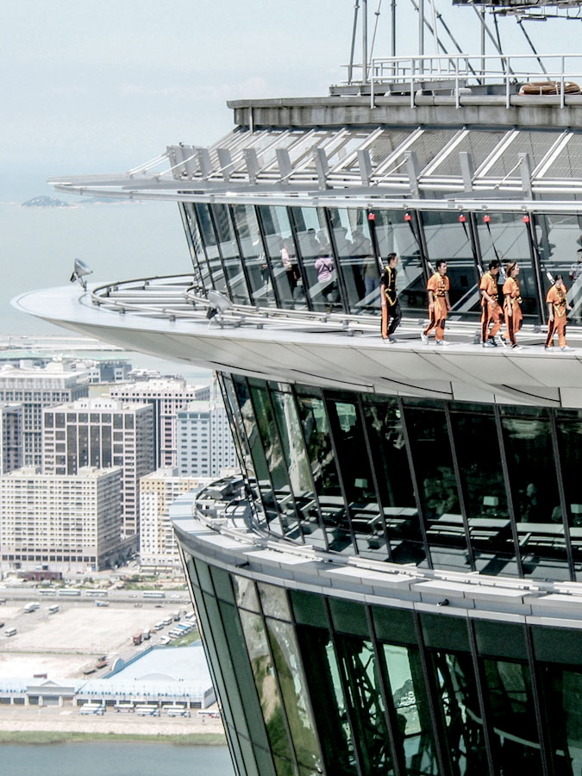

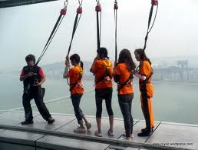
Which is easier to fall down?

Slide 7
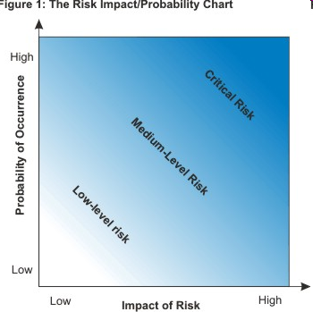
Tool for risk management: Risk Impact/Probability Chart
The Risk Impact/Probability Chart provides a useful framework that helps you decide which risks need your attention.

Slide 8
Risk Impact/Probability Chart
The Risk Impact/Probability Chart is based on the principle that a risk has two primary dimensions:

Slide 9
Risk Impact/Probability Chart
Probability (y-axis)
A risk is an event that "may" occur. The probability of it occurring can range anywhere from just above 0% to just below 100%.
(Note: It can't be exactly 100%, because then it would be a certainty, not a risk. And it can't be exactly 0%, or it wouldn't be a risk.)

Slide 10
Risk Impact/Probability Chart
Impact (x-axis)
A risk always has a negative impact.
Size of the impact varies in terms of:
cost and impact on health,
human life, or
some other critical factor.
The Impact/Probability chart allows you to rate potential risks on 2 dimensions.
probability that a risk
impact of the risk

Slide 11
What should we do in different scenario?
This chart gives you a quick, clear view of the priority that you need to give to each.
You can then decide what resources you will allocate to managing that particular risk.
A
D
B
C

Slide 12
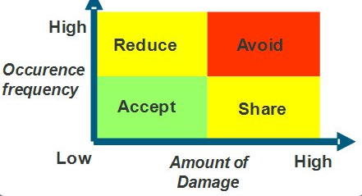
Risk Impact/Probability Chart
The corners of the chart have these characteristics:
Low impact/Low probability
Risks in the bottom left corner are low level, and you can often ignore them.
Low impact/High probability
Risks in the top left corner are of moderate importance – if these things happen, you can cope with them and move on. However, you should try to reduce the likelihood that they'll occur.

Slide 13
Risk Impact/Probability Chart
High impact/Low probability
Risks in the bottom right corner are of high importance if they do occur, but they're very unlikely to happen. For these, however, you should do what you can to reduce the impact they'll have if they do occur, and you should have contingency plans in place just in case they do.
High impact/High probability
Risks towards the top right corner are of critical importance. These are your top priorities, and are risks that you must pay close attention to.

Slide 14
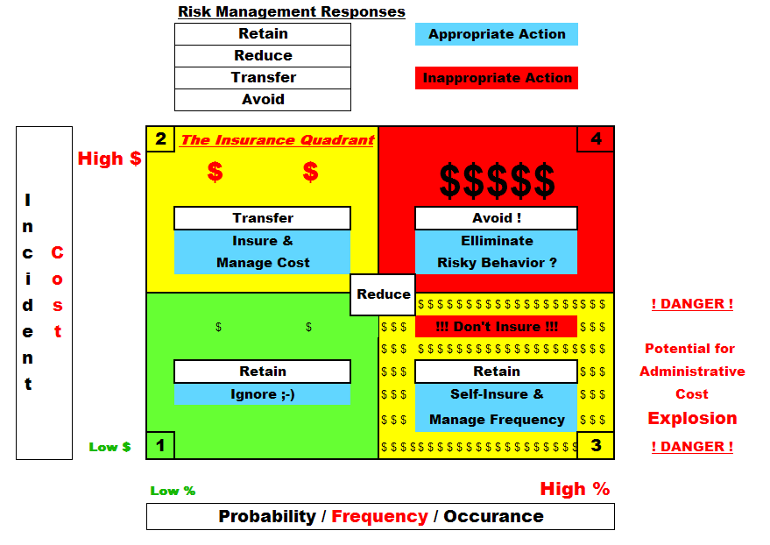
Risk Impact/Probability Chart – for an investment

Slide 15
Pitfall?
Should we simply divided the chart into 4 quadrants
Should we accept the risk with 49% probability and will cause a 49% of maximum loss?
should we avoid the risk that has a 51% probability of occurring, with a loss of 51% of maximum loss?

Slide 16

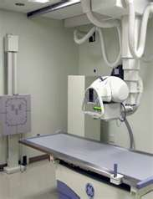
A more sophisticated and integral way to manage/measure risk
In some industries (e.g. Med Engg, Nuclear Engg, EE…etc), you need to pay close attention to even very unlikely risks, where these risks involve injury or loss of human life, for example.
Make sure you pay due attention to these risks.
List all of the likely risks that your project faces.

Slide 17
A more sophisticated and integral way to manage/measure risk
Assess the probability of each risk and assign it a rating.
E.g. use a scale of 1 to 10.
Assign a score of 1 when a risk is extremely unlikely to occur, and use a score of 10 when the risk is extremely likely to occur.
Estimate the impact on the project if the risk occurs.
Using your 1-10 scale (1 for little impact and a 10 for a huge impact.)

Slide 18
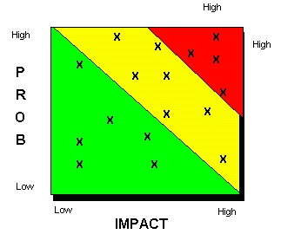
A more sophisticated and integral way to manage/measure risk
Map out the ratings on the Risk Impact/Probability Chart.
Develop a response to each risk, according to its position in the chart.
Risks in the bottom left corner (Green) can often be ignored
Those in the top right corner (Red) need a great deal of time and attention.
10
1
10

Slide 19
A more sophisticated and integral way to manage/measure risk
Total weighted risk =
Σ impact(i) x probability(i)
Project A Project B
10
10
x
x
x
x
x
x
x
x
x
x
x
x
x
x
x
1
10
1
10

Slide 20
Expected Monetary Value (EMV)
EMV is an important part of risk management, usually used in large and complex projects to perform quantitative risks analysis.
a statistical technique in risk management that is used to convert the risk into a number, which in turn assists the project manager calculate the contingency reserve, and helps compare a risk with other risks.
EMV = Probability * Impact
Probability
is the measurement of the likelihood of the occurrence of any event.
Impact
is the amount that you will have to spend if any identified risk occurs.

Slide 21
Expected Money Value (EMV)
What is the business purpose of product value calculated by multiplying the probability of an event by the cost of the impact?
Lets say you are going on a geological survey up on a mountain in the rural areas.
Risks:
High Winds Probability: 35% Impact: cost $48 to replace equipment
Landslide Probability: 5% Impact: lose $750 in damage costs
Wind generator is usable Probability: 15% Impact: save $800 in battery costs
truck rental Unavailable Probability: 10% Impact: cost $350 last-minute rental

Slide 22
Calculating EMV
Calculating EMV for each
Risk High Winds: 35% x -$48 = -$16.80
Landslide: 5% x -$750 = -$37.50
Wind Generator: 15% x $800 = $120
Truck Rental: 10% x -$350 = -$35
Expected Money Value of the risk
= -$16.80 + (-$37.50) + $120 + (-$35)
= -$30.70

Slide 23
Calculating EMV
There are usually multiple risks in a project, we need to calculate the EMV of those risks separately and add them all, regardless of whether they are positive risks or negative risks.
Once you calculate the EMV of the project, you will be able to calculate the contingency reserve.
The probability is used in the calculation to take into account the fact that not all risks are going to happen.
So, in this example we only need to add $30.70 to the budget to cover all identified risks.

Slide 24
Using the Risk Impact/Probability Chart to prioritize risks
To successfully implement a project, you must:
identify and focus your attention on middle and high-priority risks
otherwise you risk spreading your efforts too thinly
you'll waste resources on unnecessary risk management.
Use Risk Impact/Probability Chart to check out each risk
its position determines its priority
High-probability/high-impact risks
are the most critical, and you should put a great deal of effort into managing these.
low-probability/high-impact risks and high-probability/low-impact risks are next in priority
though you may want to adopt different strategies for each.
Low-probability/low-impact
risks can often be ignored.

Slide 25

Risk and Return
Risk and return are usually proportional
High risk high return (Real life)
Low risk low return (Real life)
High risk low return
Only fool will go for it.
Low risk high return
Too good to be true

Slide 26
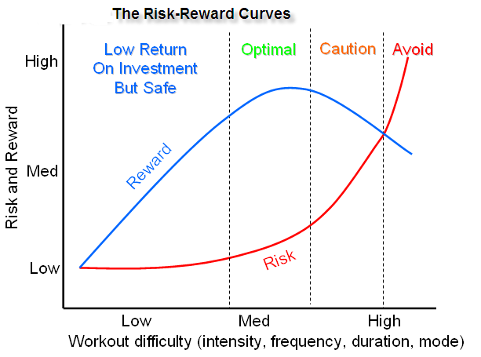
Another tool: Risk Reward curves
Characteristic of the Risk Reward curves

Slide 27
Crisis management

Slide 28
Crisis management
Crisis management is the process by which an organization deals with a major event that threatens to harm the organization, its stakeholders, or the general public.

Slide 29
Crisis management
4 elements are common to most definitions of crisis:
(a) a threat to the organization,
(b) the element of surprise, and
(c) a short decision time.
(d) the need for change (when the old system can no longer be maintained.)

Slide 30
Risk management vs Crisis Management
Risk management
involves assessing potential threats and finding the best ways to avoid those threats
Crisis management
involves dealing with threats after they have occurred.
Is it true to say that
“Crisis Management represents a failure of Risk Management”

Slide 31
Risk management vs Crisis Management
Not necessary since it will never be possible to totally mitigate the chances of serious risk occurring.
10
x
1
10

Slide 32

The new coke crisis
In 1985, the 99 year old secret formula for Coca-Cola was being replaced by New Coke.
Their customers disliked the change
the protest,
the countless calls their hotline
the lawsuits
How Coca-cola managed the risk?

Slide 33
Action to solve the crisis
Finally admission of a mistake by The Coca-Cola Company 79 days later when Coca-Cola was returned to the market as "Classic" Coke.
Made a press conference for the return of Coke Classic
Considered as the greatest performance by an America businessmen by a key marketer at the time.

Slide 34

Crisis of the new coke
https://www.youtube.com/watch?v=t_djFC9Uhuw

Slide 35
Crisis Management
It is a discipline within the broader context of management consisting of skills and techniques required to identify, assess, understand, ease and overcome a serious situation from the moment it first occurs to the point that recovery procedures start.
Access
Ease
Identify
Overcome
Understand

Slide 36
Crisis Management Plan
What are the major elements in the Crisis Management Plan?
M
Metrics (Measures)
Methods
Message
M
Crisis Management Plan
M

Slide 37
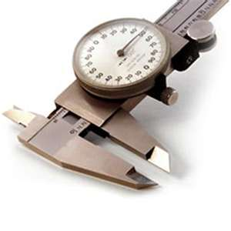

Crisis Management Plan
Crisis management consists of:
Metrics
to define what scenarios constitute a crisis and should consequently trigger the necessary response mechanisms.
Methods used to respond to both the reality and perception of crises.
Messages (Communication)
that occurs within the response phase of emergency management scenarios.
Crisis Management Plan

Slide 38


Case study: iPhone 4 Antenna Problem
Apple's iPhone 4 signal problems have been complained by customers
When iPhone 4 users grip the device from the lower left corner (when holding the phone by its metal sides in two opposite places), the signal is poor
Jobs replied to the complaints: "Non issue. Just avoid holding it in that way."
"Non issue. Just avoid holding it in that way

Slide 39

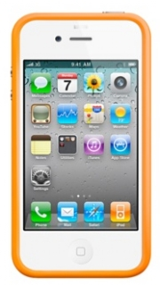

Risk management
Corrective actions
Technical:
Need a real practical solution to solve the problem (short term and long term)
Customer psychology:
Give advantages to customers
Apple currently sells a $29 rubber "Bumper Case" for the iPhone 4 (indicates that Apple already knew about the potential reception issues with the phone.)
Give them free to the customers
Turn risk into opportunity
Provide different color options
Make it as a trendy fashion

Slide 40
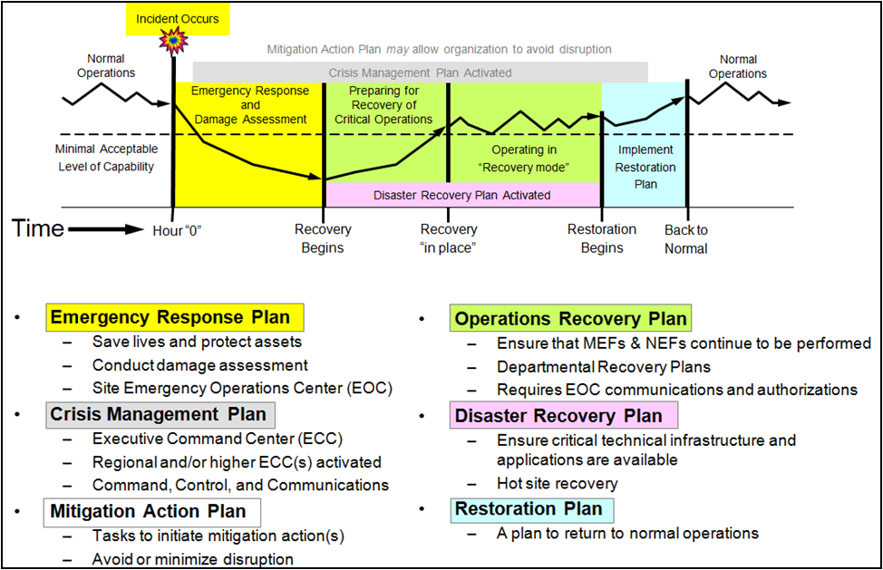
Risk management cycle
"Non issue. Just avoid holding it in that way
New design

Slide 41
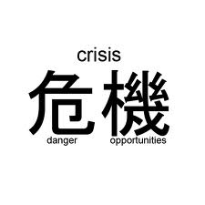
Crisis as Opportunity
Crisis leadership is very important
A good leader should have a mindset of “crisis is an opportunity“
Leaders who perform well under pressure can effectively guide the organization through such crisis.

Slide 42
Crisis as Opportunity
Crisis leadership, on the other hand, immediately addresses both the damage and implications for the company’s present and future conditions, as well as opportunities for improvement.
E.g. the iPhone Antenna problem was turned into an opportunity

Slide 43
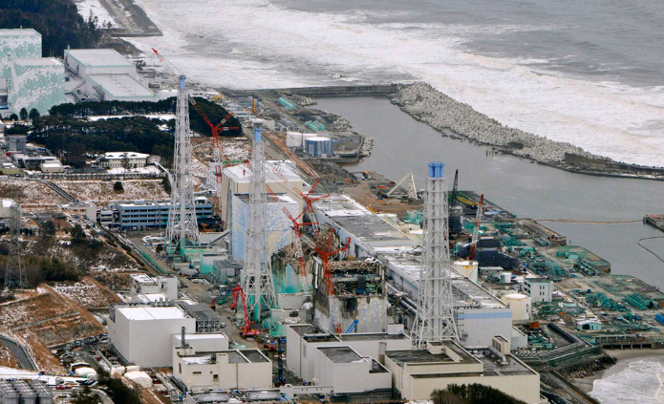
Consequence of bad crisis management
Case study: Fukushima nuclear disaster
What are the crisis? What are the problems?

Slide 44
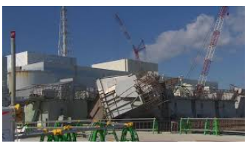
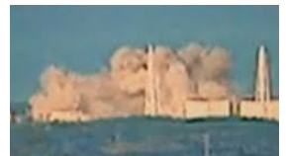
Consequence of bad crisis management
The Japanese government did not keep records of key meetings
Data was not shared with others.
Emails from NISA to Fukushima holding vital information for evacuation and health advisories were unread and were deleted.
The data was not used because the disaster countermeasure office regarded the data as “useless”
Reference:
https://en.wikipedia.org/wiki/Fukushima_Daiichi_nuclear_disaster#Poor_communication_and_delays
The vital mistake:
Poor communication and delay!!

Slide 45

What are the vital mistakes in this risk management?
Gradual (bit by bit) disclosure of facts and evidences
(like squeezing toothpaste)
Failure in damage assessment
Loss trust and integrity
Failure to take corrective actions
Failure to demonstrate accountability

Slide 46
Develop a crisis mindset
A crisis mindset requires the ability to think of the worst-case scenario while simultaneously suggesting numerous solutions.
It is necessary to maintain a list of contingency plans and to be always on alert.
Organizations and individuals should always be prepared with a rapid response plan to emergencies which would require analysis, drills and exercises.

Slide 47
Develop a Contingency planning
A good practice for Contingency planning
Crisis management teams can rehearse a Contingency planning (crisis plan) by developing a simulated scenario to use as a drill.
The plan should clearly stipulate that the only people to speak publicly (assign a good spokesperson)
The first hours after a crisis breaks are the most crucial, so working with speed and efficiency is important, and the plan should indicate how quickly each function should be performed.
When preparing to offer a statement externally as well as internally, information should be accurate.
Providing incorrect or manipulated information has a tendency to backfire and will greatly exacerbate the situation.

Slide 48
Crisis Communication
Identifying audiences
Who are we talking to? Media? Shareholder? Students? Parents? Patient?
How communication is to take place (How?)
Press conference? Blog? TV/radio? Newspaper Ad?
What messages are to be communicated (What?)

Slide 49
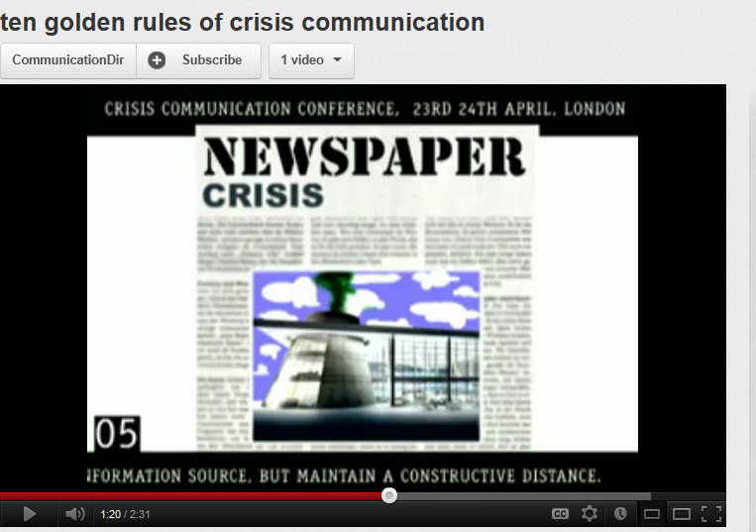
Crisis Communication
http://www.youtube.com/watch?v=qM7liob6DPs&feature=related

Slide 50
10 golden rules for crisis communication
1. Acknowledge mistakes
2. Take quick action
3. Have a long-term strategy
4. Communicate from management to all levels
5. Be a reliable source for the media at a comfortable distance
6. Restrain the desire to win the argument
7. If appropriate and honest, dare to overreact
8. Do not try to create consensus
9. Consider all key audience in communications
10. Never stop monitoring problems and issues

Slide 51
Crisis communication: Credibility and reputation
The credibility and reputation of organizations is heavily influenced by the perception of their responses during crisis situations.
The organization and communication involved in responding to a crisis in a timely fashion makes for a challenge in businesses.
There must be open and consistent communication throughout the hierarchy to contribute to a successful crisis communication process.

Slide 52

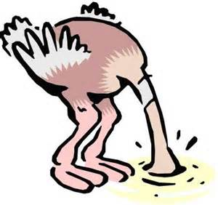
What messages are to be communicated (What?)
Possible options
Full apology
Corrective action
Justification
Excuse
Denial
Attack the attacker

Slide 53

What messages are to be communicated (What?)
Possible actions for apology
Cash compensation
Refund of goods and services
Alternative substitutes (from most ideal to least acceptable)
Immediate medical and logistic support, hotline
Letter of apology
Policy review and modification
Follow up PR, image promotion

Slide 54
The right attitude of crisis communication
Acceptance of responsibility
Willingness to take positive steps
Active, two-way communication
Tell the truth as it is known (Don’t tell lies)
Inform the audience what actions have been/will be taken
Acknowledgement of emotions/psychological needs

Slide 55
Media demands
Accuracy and simplicity
Statistics which are explained
Don’t just say “many customers are happy with our service”
Do say “36% of our customers rate Highly Appreciate and 42% rate Appreciate with our service”
Context of information
Comments from highest authority
Some controversial elements
Both sides of the issue
Also address the opposite side
Speed, speed and speed

Slide 56
References
http://www.mindtools.com/pages/article/newTED_03.htm
http://www.feddisasterrecovery.com/resources/continuity-of-operations--how-resilient-are-your-essential-functions-/

